Slide 1
Award Winning Seals

Slide 2
Batchelor Award
Award for non-English book

Slide 3
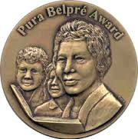
Pura Belpre
Author or Illustrator honoring Latino culture

Slide 4
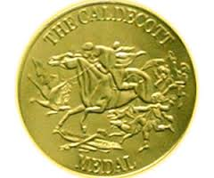
Caldecott
Best Illustrator/Pictures

Slide 5
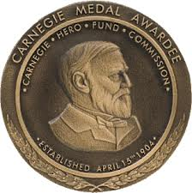
Carnegie
Best Book turned into Video

Slide 6
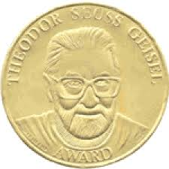
Geisel Award
Author and Illustrator: Best Book for Beginning Readers

Slide 7
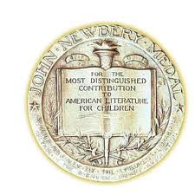
Newbery Award
Best Words

Slide 8
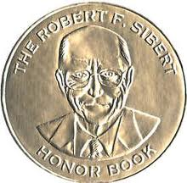
Siebert Award
Best Informational Book

Slide 9
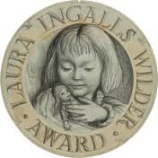
Wilder Award
Noted Illustrator or Author Over Time

Slide 10
Coretta Scott King
Best African-America author and/or Illustrator

